Slide 1


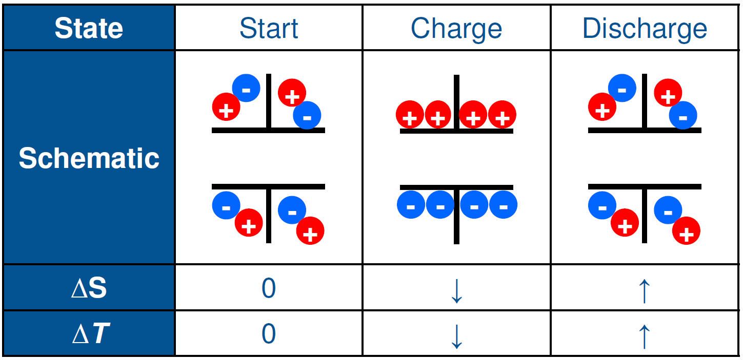
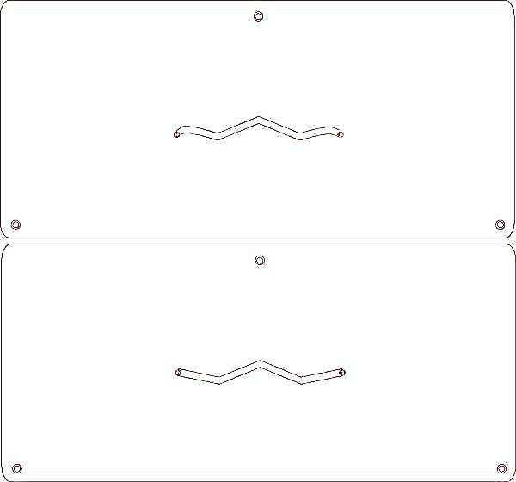
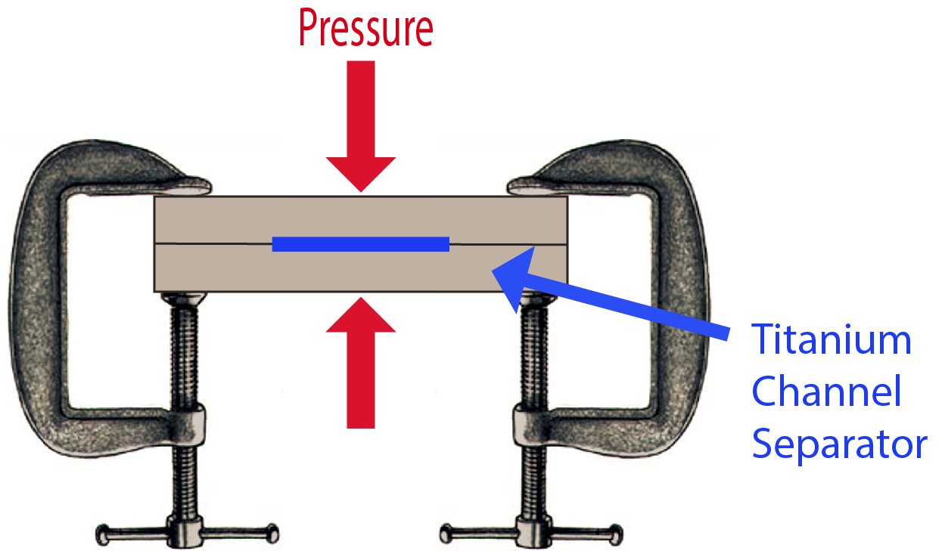
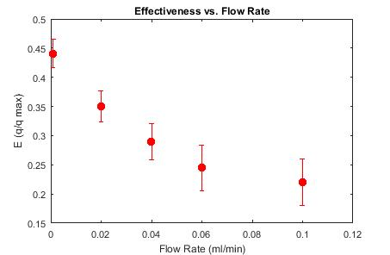
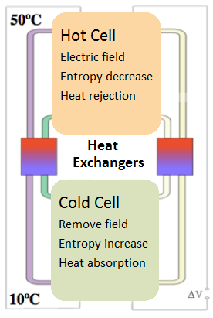
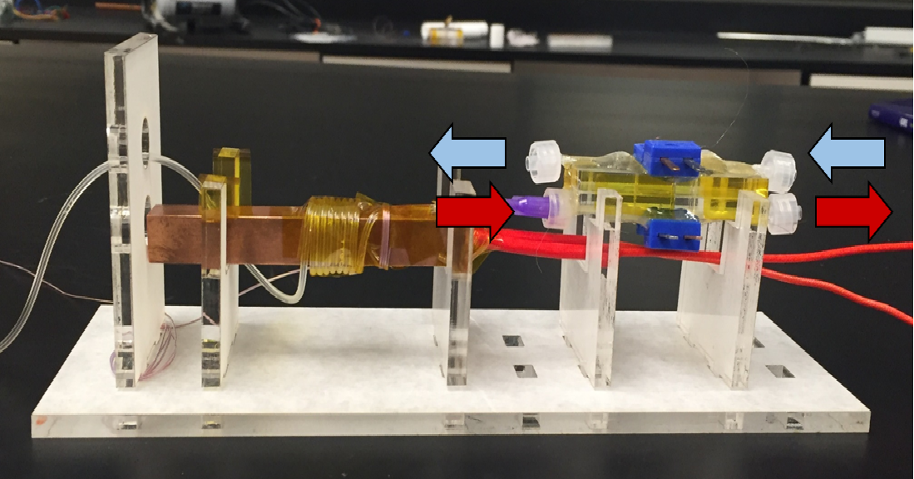
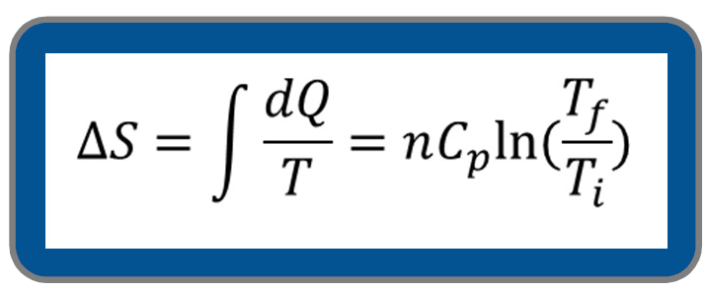

Ionocalorics & Microfluidic Heat Exchangers
Aristos Athens¹, Ian McKay¹, Arun Majumdar¹
1. Mechanical Engineering, Stanford University
Ionocaloric Cooling
Ionocalorics is a novel approach to refrigeration. Applying a magnetic field to a pool of ions will separate them, reducing entropy and thus reducing temperature.
Heat Exchangers
Heat exchangers were fabricated from laser cut acrylic. Two separate pieces are rastered to form shallow channels, a separating slice of titanium is inserted, then all pieces are bonded together by clamping and heating them at 170° C for 35 minutes.
There are holes at the end of each channel for fluid delivery and temperature probes. Holes near the edges for facilitating alignment. Holes are cut all the way through the thickness of the acrylic.
Testing & Data
Heat Exchanger effectiveness was evaluated using the NTU (Number Transfer Units) Method:
$E= \frac{\dot{q}}{\dot{q_{max}}}= \frac{C_{cold }(T_{cold,out} − T_{cold, in})}{C_{min}(T_{hot,in} −T_{cold,in})}$
Where Heat Capacity Rate: $C=c∗\dot{m}$
Fluid flow rate was the independent variable. Generally, effectiveness increases with decreasing volumetric flow, but at very low flow rates convective heat loss through tubing surface had to be accounted for.
This process can be combined with a redox reaction to further improve cooling
A fluid Heat Exchanger is critical for the efficient operation of such a device. An exchanger that transfers heat from the hot to the cold fluid flows obviates the need for an energy-using heater.
When bonding is complete, thermocouples (blue devices) and tubing (not shown) are inserted and epoxied. Hot fluid runs along the bottom channel (red arrows) counter to the cold flow (blue). For testing purposes, hot inlet tubing was wrapped around a copper heater (left) to simulate the temperature of the Hot Cell.
Charging (negative ΔS) occurs in the hot cell, and discharging in the cold cell, so as to maximize heat rejection.
The cold cell returns to the original entropy state. For a set ΔS, lower temperature means improved heat absorption.
As flow rate approaches zero, effectiveness approaches its maximum value. For our design, it appears that Effectiveness is between 0.4 and 0.45 for the micro flow rates we are interested in.
These efficiencies are high enough to show that ionocaloric cooling can be a faster and more energy efficient method of refrigeration than traditional vapor compression systems.

